Slide 1
Developed By:- Anirudh Mishra Anisha Arora
Vehicle Service Alert

Slide 2
Introduction
It’s a tool which makes the user aware that their vehicle needs service.
Its Basic parameter on which it is based on is vehicle mileage.
OOP’s features used are:
: classes and objects
: Dynamic Memory Allocation
: Inheritance and File Handling

Slide 3
Why we need this tool ?
Acc to the research done by IIT Kanpur students ,they found that more than 70% people in India always get delayed in gettiing their vehicle serviced
Following is the pie chart demonstarting the same:

Slide 4
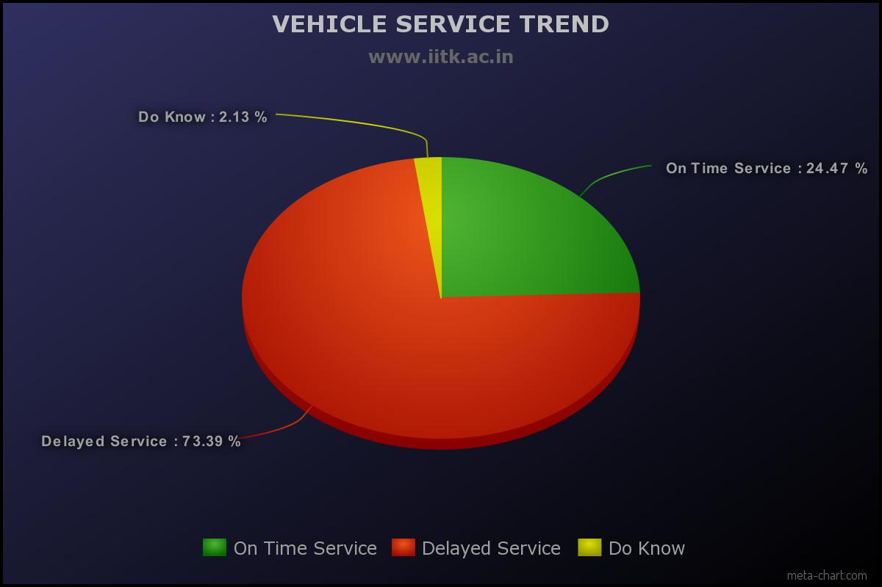

Slide 5
Conclusions of Delayed Service
Pollution
Vehicle which is not serviced properly starts emitting more harmful fumes as it becomes a major source of pollution.
Following is the graph showing when vehicle is serviced regularly :

Slide 6
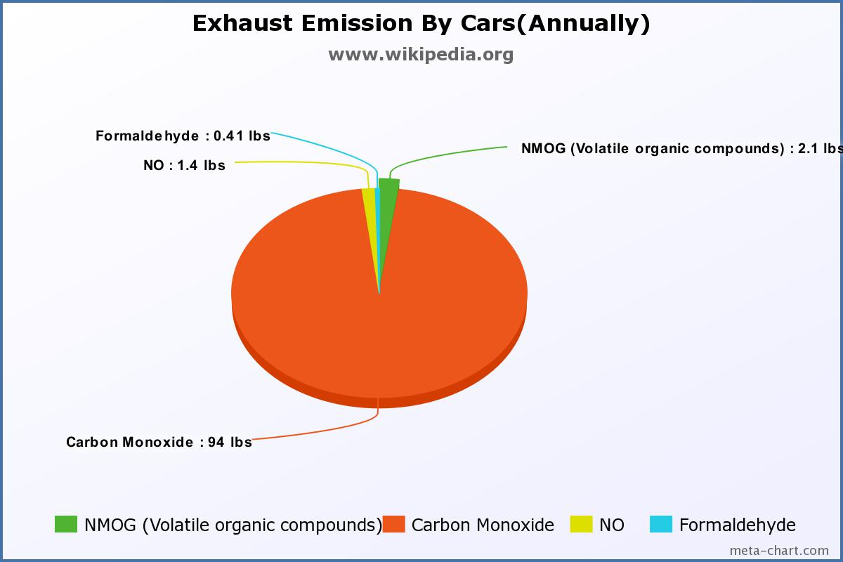

Slide 7
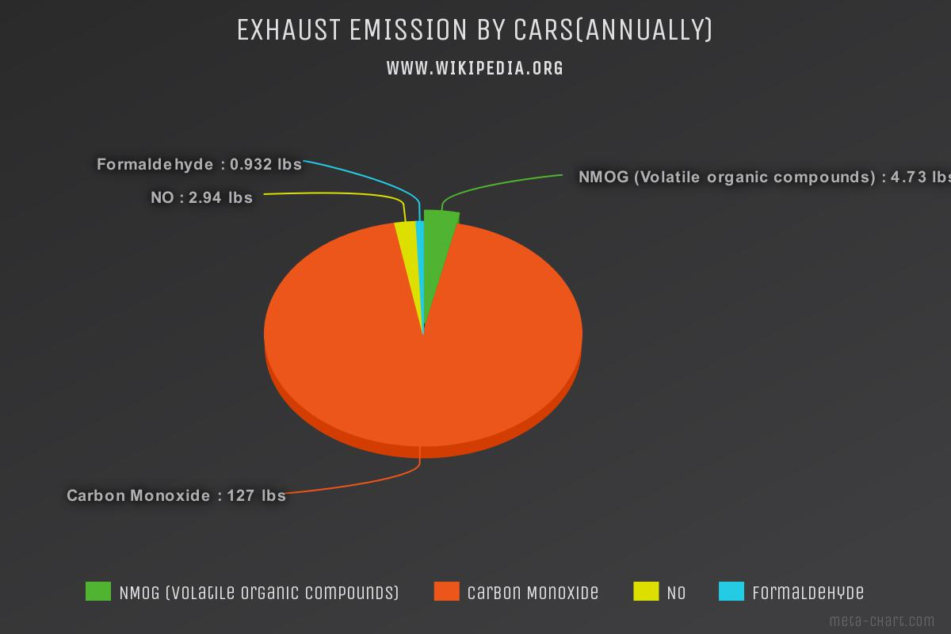
Emission By Delayed Serviced Car:

Slide 8
Conclusions:
Low efficiency
Car with delayed service there ,mileage goes down it consumes more fuel resulting in depletion of fossil fuels at the high rate.
Graph showing the difference between the mileage of well serviced and delayed one :

Slide 9
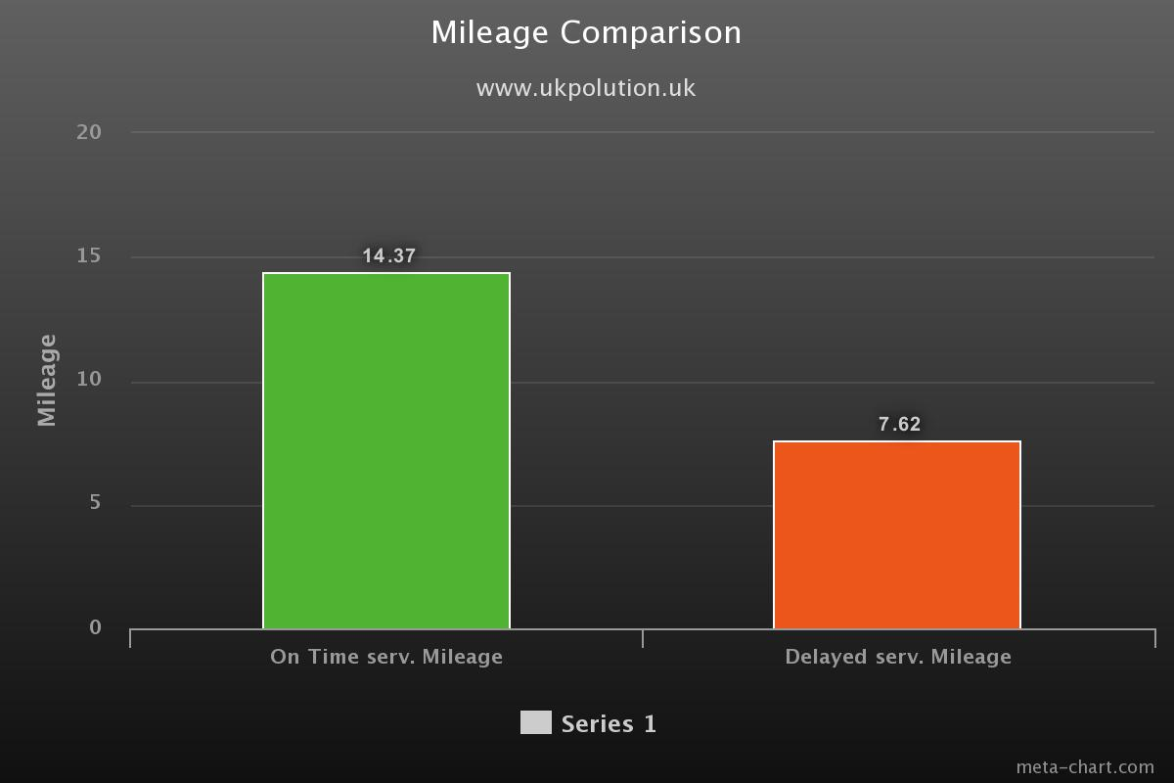

Slide 10
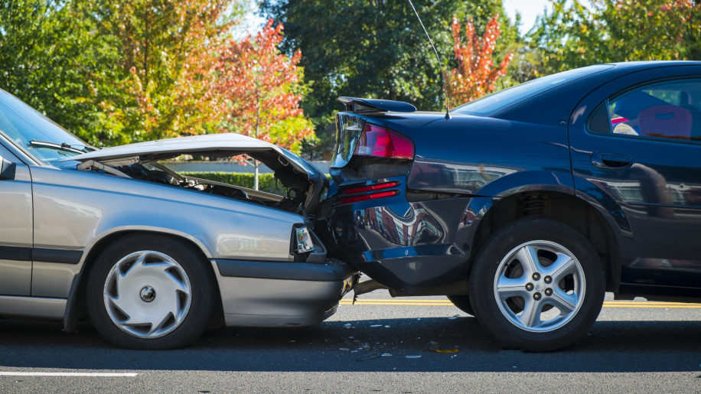
Conclusion:
Accidents:
The delay in service can lead to accidents.

Slide 11
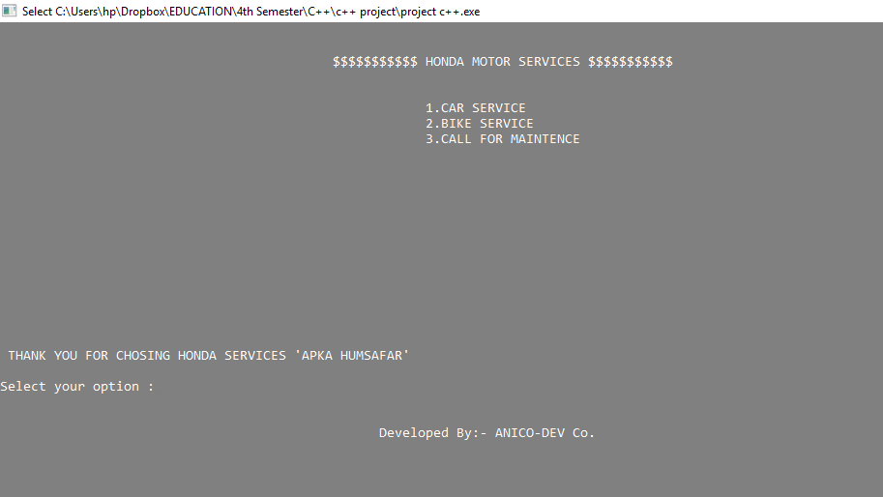
So we developed this tool:
Vehicle Service Manager

Slide 12
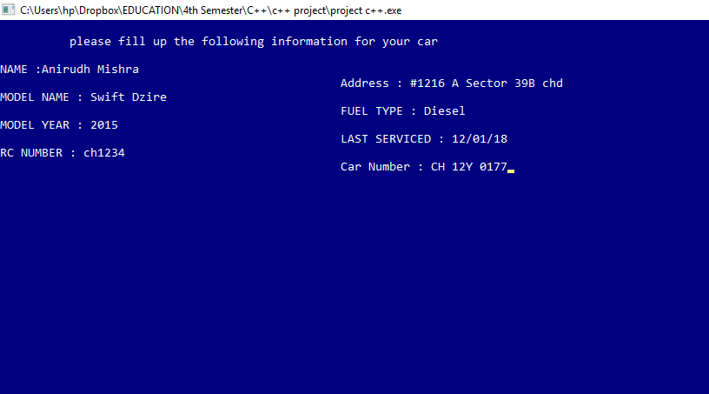
Checking mileage of Car you own :
FOR THIS SELECT OPTION 1 and Enter your information asked :

Slide 13
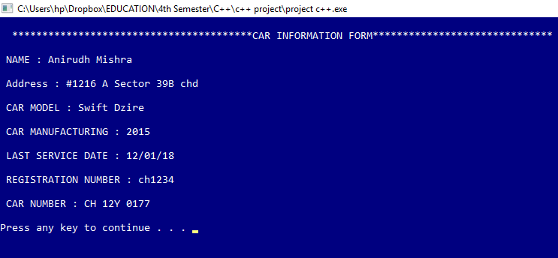
Now it shows what you have entered:

Slide 14
SERVICE CALCULATOR PORTAL
Enter your distance and fuel reading
Now it will calculate that if your vehicle needs service or not
Now enter whether you want to print the service token or not

Slide 15
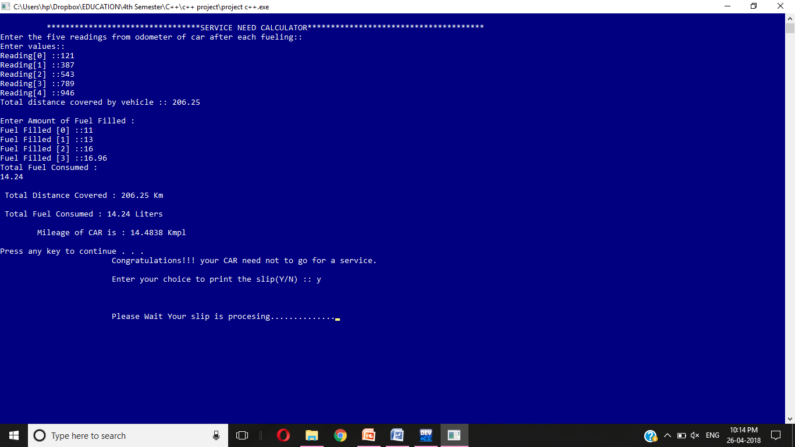

Slide 16
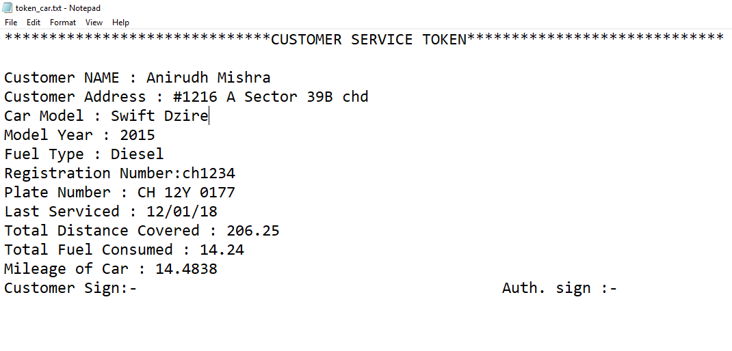
Service Token ::

Slide 17
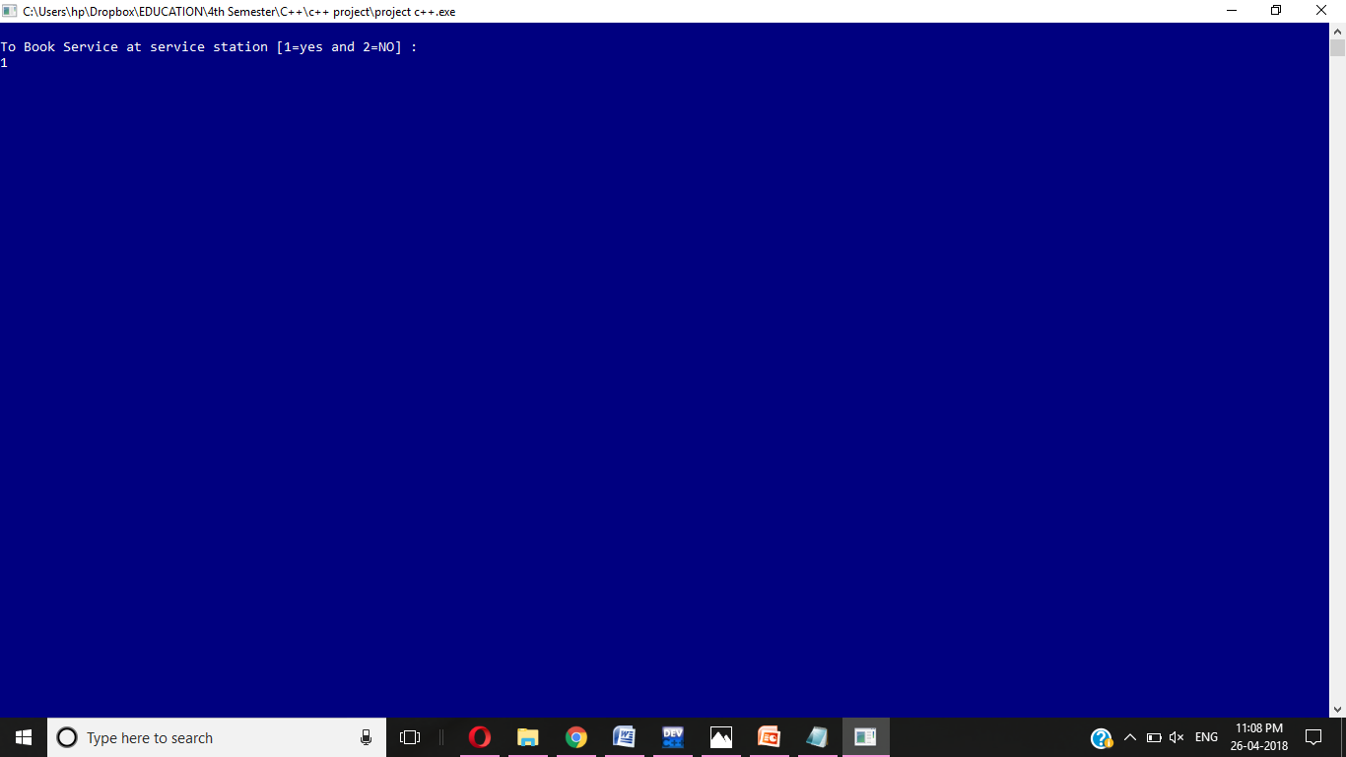
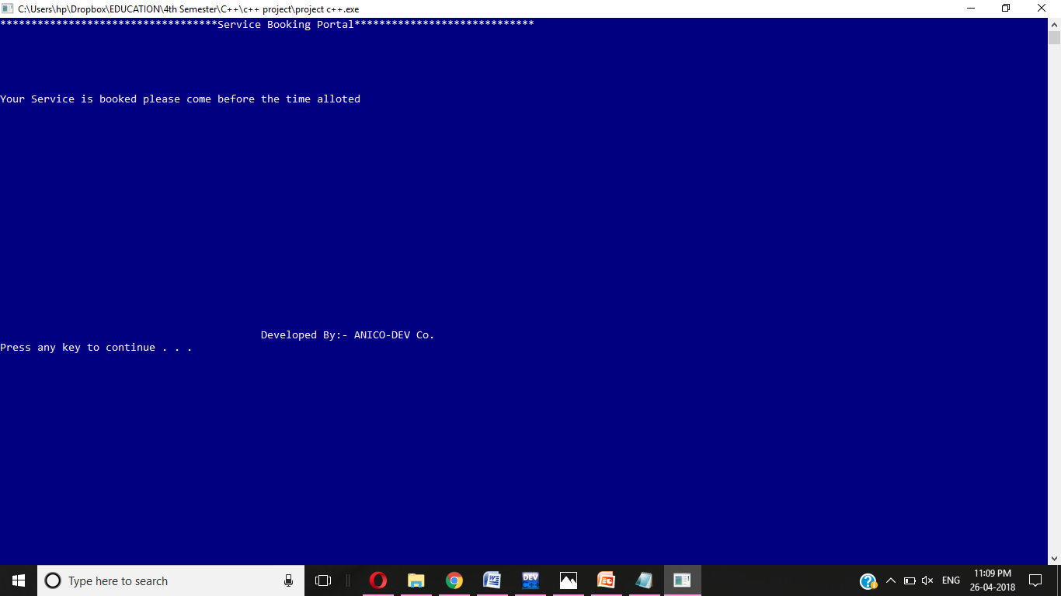
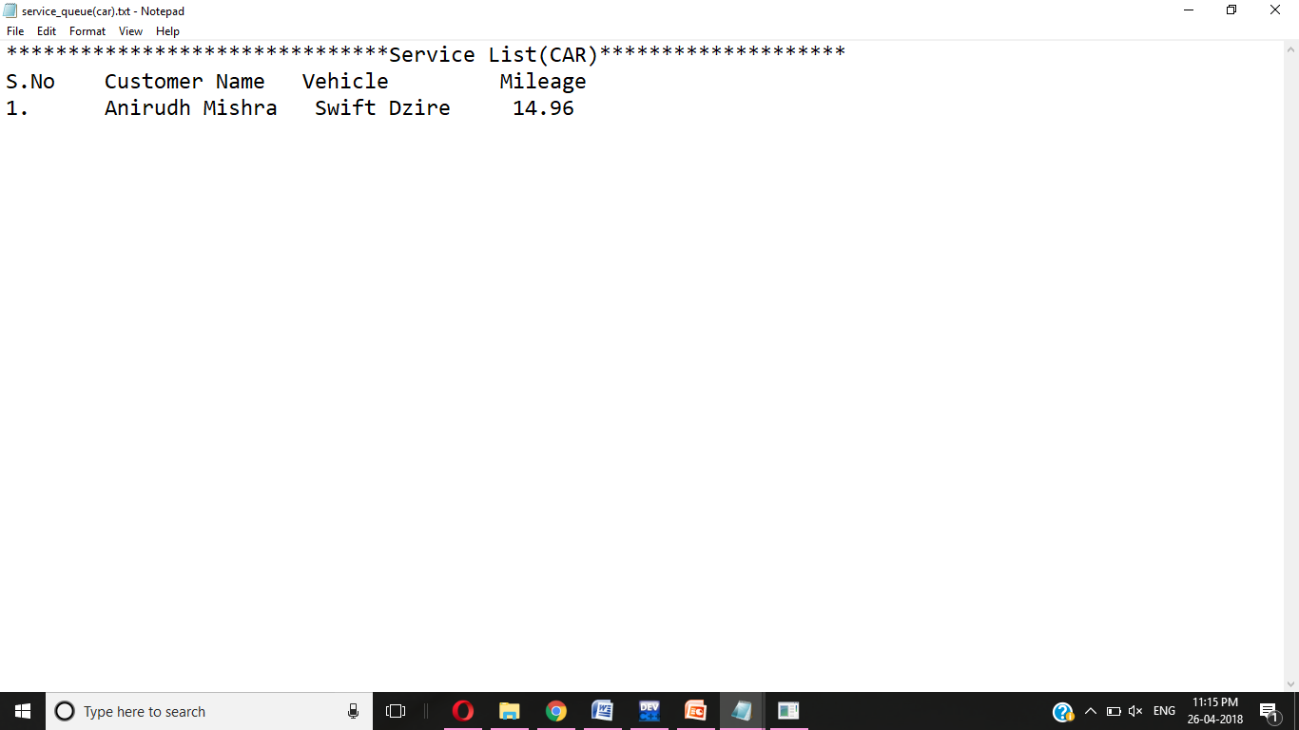
Enter 1 to book the service for the vehicle

Slide 18
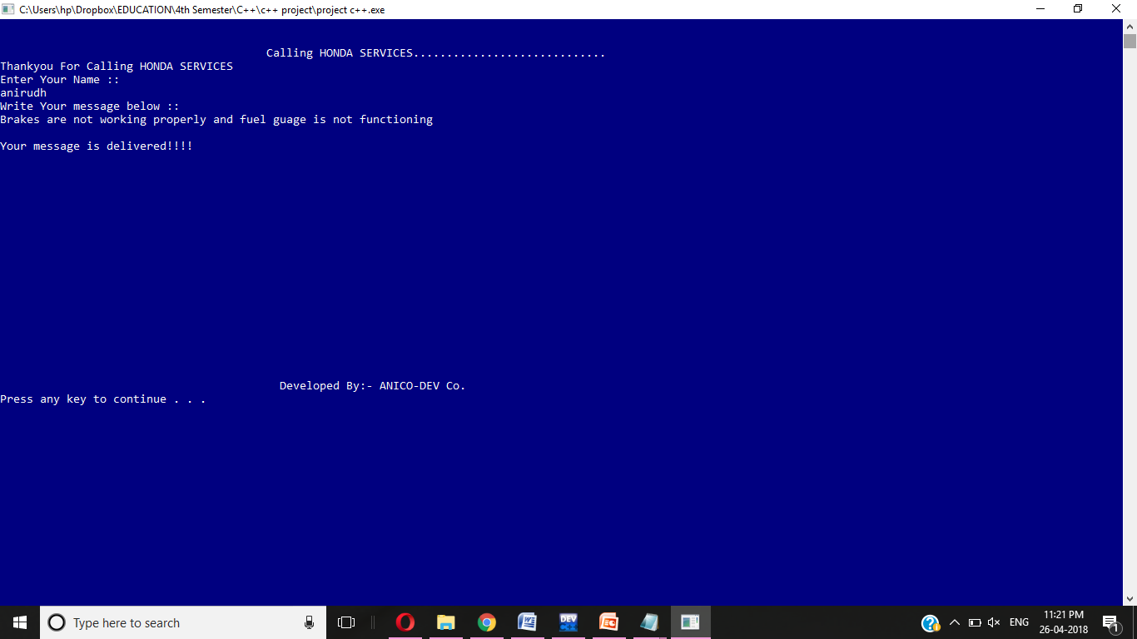
Now we have given customer a portal to call the customer care and make your complaint

Slide 19
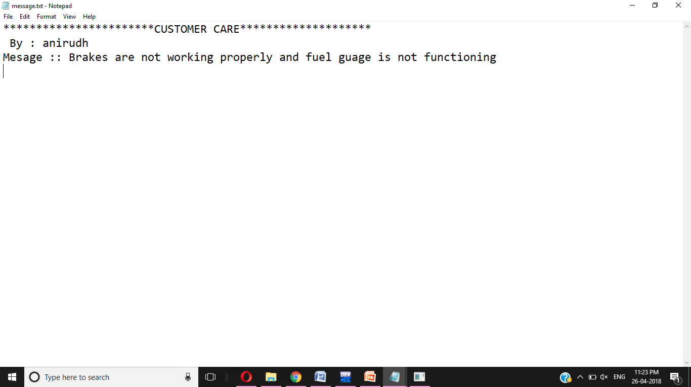
Message:

Slide 20
Advantage:
Lower the air and noise pollution
Efficiency will increase
Lower the risk of accidents
Will save money of the owner

Slide 21
Future Scope :
Android App :
It will be app consisting of functions like service Mileage tracking, auto alerting, Fuel filing frequency counter.
Artificial Intelligence :
: It will be an algorithm which will tell the driver to drive at prescribed speed in order to maintain the car condition.
:using AI car can go for service on its own when an alert is send by the tool present in the software.

Slide 22
Thank you

